Slide 1
Predicting Personality Types from Social Media Posts using Deep Learning
Team Members Panel Number:11
Project Advisor: Dr.Madhusudana Rao Nalluri
Asst. Professor/ CSE
S.No | Reg.No | Name of the Student | Section
1 | CB.EN.U4CSE18017 | Gullapudi Rohith Gupta | CSE A
2 | CB.EN.U4CSE18044 | Pranesh M | CSE A
3 | CB.EN.U4CSE18052 | Shyam Sreevalsan | CSE A
4 | CB.EN.U4CSE18501 | Harish K | CSE A

Slide 2
Problem definition
To predict personality types of users from social media posts using deep learning techniques.

Slide 3
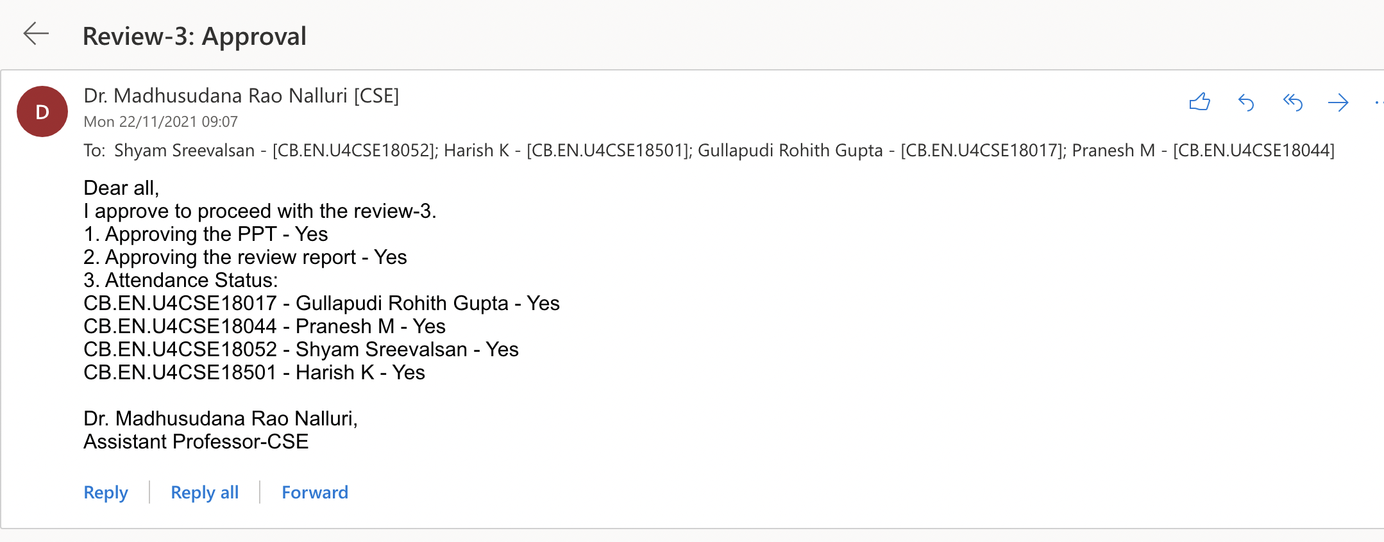
Guide Approval

Slide 4
Review-2 Comments
Comments
Ethical Issues to be addressed
Find some positive aspects
Inferences
Data can be obtained only from voluntary users who wish to identify their personality and contribute to the prediction system.
One of the positive aspects of this project include:
- It helps psychologists to better understand individuals as they can identify the personality of the users in a long term, thereby providing better counselling.
The main objective is to understand the concepts involved in Natural Language Processing and Deep Learning, so that we can propose an efficient text classification system.

Slide 5
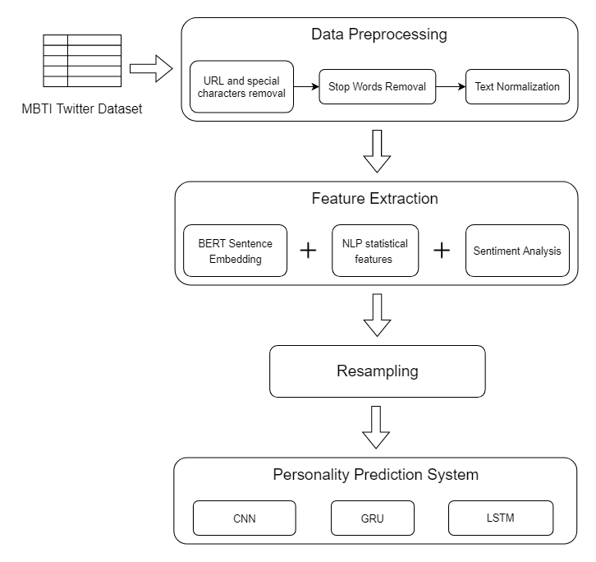
Architecture Diagram

Slide 6
Explanation of Architecture Diagram
The MBTI dataset is obtained from Kaggle. The tweets are unstructured data in the form of text. As the tweets contain meaningless information in the form of links and symbols, preprocessing using various techniques is done.
The preprocessed text is then used to extract numeric features, so that it can be fed to the deep learning models. We make use of both pre-trained language model (BERT) and NLP statistical features in Feature Extraction.
In order to improve performance, sentiment information contained in the tweets is also analyzed, which can serve as a valuable feature.
In the MBTI dataset, it can be seen that there is a serious data imbalance between personality traits. Therefore, resampling is essential in order to produce unbiased results.
The extracted vectors, after resampling, are then fed to three neural network models namely CNN, GRU and LSTM and their performances are analysed.

Slide 7
Project Modules
Personality Dataset Identification
Data Pre-processing
Feature Extraction
Sentiment Analysis
Resampling
Personality Prediction
Performance Analysis

Slide 8
Personality Dataset Identification
Available personality datasets with standard personality labels are rare, and their collection is difficult due to the privacy issues involved, besides the cost of finding professional psychologists for labeling is expensive.
We decided to use one of the public personality datasets that are more commonly and currently used.
Two of the famous publicly available datasets are the MBTI dataset from Twitter tweets and the myPersonality dataset which is based on Big Five Model.
The myPersonality dataset, the largest dataset in the Big Five personality field, was made unavailable in 2018 due to privacy leaks.

Slide 9
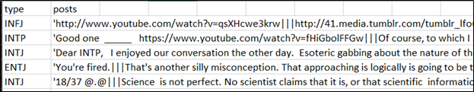
Personality Dataset Identification
The MBTI personality type dataset is a standard dataset and it is the largest publicly published personality dataset that is available. The dataset is available on the Kaggle website and permission has been given for its use in academic research.
MBTI Twitter Dataset

Slide 10
Data Pre-processing
Different preprocessing techniques and various feature selection are exploited, for more exploration of the personality from text. These techniques include tokenization, removal of URLs, user mentions and Hashtags, stop words elimination, word stemming and feature selection.
Tokenization: Tokenization is essentially splitting a phrase, sentence, paragraph, or an entire text document into smaller units.
Each of these smaller units are called tokens.
Stop Words Removal: Stop words are a set of commonly used words in a language. Examples of stop words in English are “a”, “the”, “is”, “are” and etc.
Word Stemming: Word stemming is one of the text normalization techniques which is used to reduce the inflection in words to their root form. Stem words are produced by eliminating the pre-fix or suffix used with root words.

Slide 11
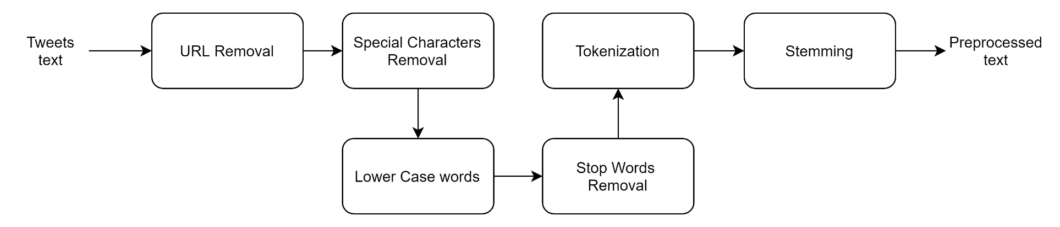
Data Pre-processing

Slide 12
Feature Extraction
Feature extraction is one of the most important modules in any classification system that is trained from non-numerical data. It is the process of transforming arbitrary data into numerical features usable for machine learning and deep learning approaches.
In the identified twitter dataset which is based on MBTI personality model, we find that each sample data has multiple Twitter tweets or sentences.
Most of the current studies use a single Twitter tweet or sentence for personality detection.
As personality is a long-term stable characteristic, it would be a better choice to use the text from multiple consecutive Twitter tweets for personality detection.

Slide 13
Feature Extraction
We will use a fine-tuned BERT model to encode each word in the sample into a vector representation, which is the process of word embedding. The Keh at al. BERT model for single sentence word embedding to train the personality detection model ignores the connection between consecutive social media text.
In order to correlate consecutive data texts, we will try to implement an approach based on the BERT model for sentence-level embedding.
We will also try combining the NLP statistical features extracted from methods such as TF-IDF and Sentiment Analysis.
TF-IDF is a technique to quantify words in a set of documents. We generally compute a score for each word to signify its importance in the document and corpus.

Slide 14
Sentiment Analysis
To further explore and leverage information, sentiment knowledge of the text is a suitable option, as the current personality dataset does not have any sentiment labeling.
SenticNet5 is a popular tool used for extracting common sense knowledge along with associated sentiment polarity and effective labels from the text. The SenticNet5 Dictionary can effectively extract the emotional tendency (positive/negative) of certain words and give the corresponding polarity score x∈(−1,1).
After proper sentiment analysis of the textual data, we can concatenate the previous connection of multiple text vectors with the sentiment vector and input them into different neural networks for training and learning.

Slide 15
Resampling
Imbalanced dataset can be defined as a distribution problem that arises in classification where the number of instances in each class is not equally divided. Whenever, an algorithm is applied on skewed and unbalanced classified dataset, the outcome always diverge towards the sizeable class and the smaller classes are bypassed for prediction.
This drawback of classification is known as class imbalance problem. In the MBTI dataset, it can be seen that there is a serious data imbalance between EI and SN dimensions.
Therefore, it is important to balance this sparsity using resampling techniques. Oversampling using Synthetic Minority Oversampling Technique(SMOTE) and undersampling technique Cluster Centroids are analysed and the better technique is preferred.

Slide 16
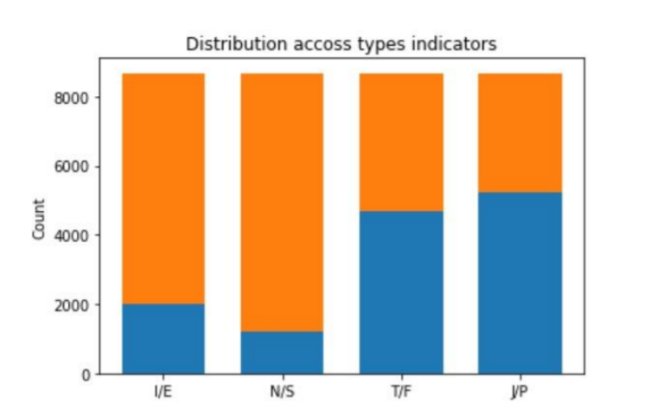
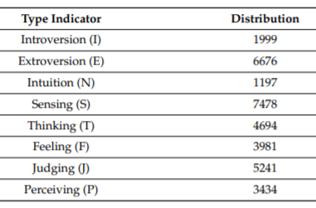
Resampling
Distribution of Personality Traits among tweets
Imbalance in Personality Traits distribution

Slide 17
Personality Prediction
Deep learning method has become more and more popular in recent periods, where several related studies use neural network architectures such as CNN and LSTM in making the best model for personality prediction systems.
In our project, multiple deep learning architectures will be implemented by combining the statistics based text features and predefined model(BERT) features to improve the performance in predicting a personality of a person.
We will implement three different neural network models in the classification task for the experiments: the CNN, the GRU, and the LSTM.
Convolutional Neural Networks(CNN) is a neural network architecture which is widely used for unstructured data classification, such as text and images.

Slide 18
Personality Prediction
A GRU is essentially a type of Recurrent Neural Network.
To explore the relationships between consecutive sentences, we use the neural network structure of the GRU, which can capture the correlations between successive consecutive statements well.
Long Short-Term Memory is an artificial RNN architecture. Unlike standard feedforward neural networks, LSTM has feedback connections.
It can process not only single data points, but also entire sequences of data. LSTM is also used for validation in order to better understand whether the text sequence affects the classification effect.

Slide 19
Performance Analysis
In our proposed personality prediction system, we will implement several deep learning models, which is trained on combined the statistical based text features and predefined model features.
Analysing performance of the models play a major role in identifying the drawbacks and improving accuracy.
Hence the models will be evaluated and compared based on several metrics such as accuracy, precision, recall and F1 score.
Fine-tuning BERT model and deep learning models is done based on the observed results.

Slide 20
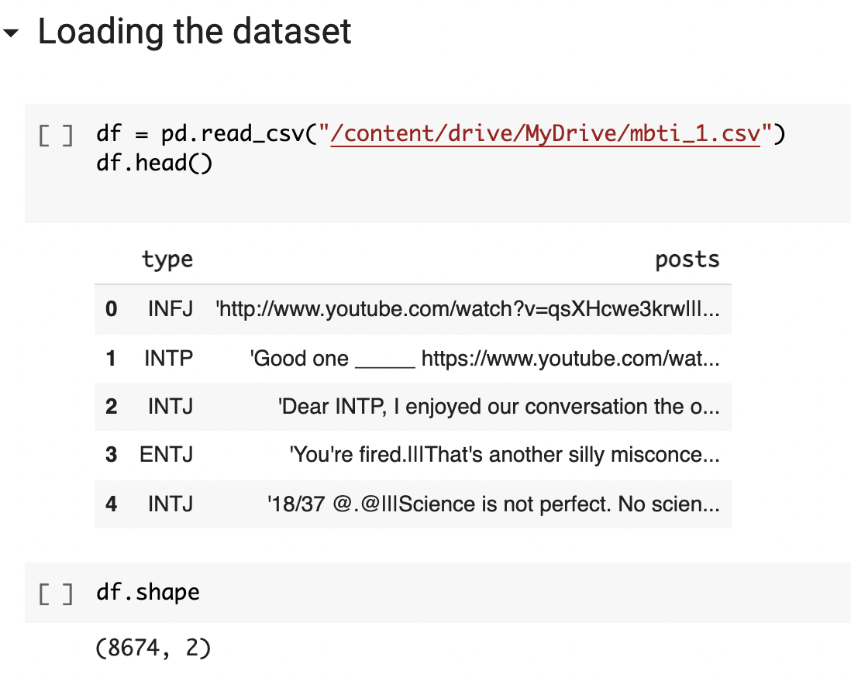
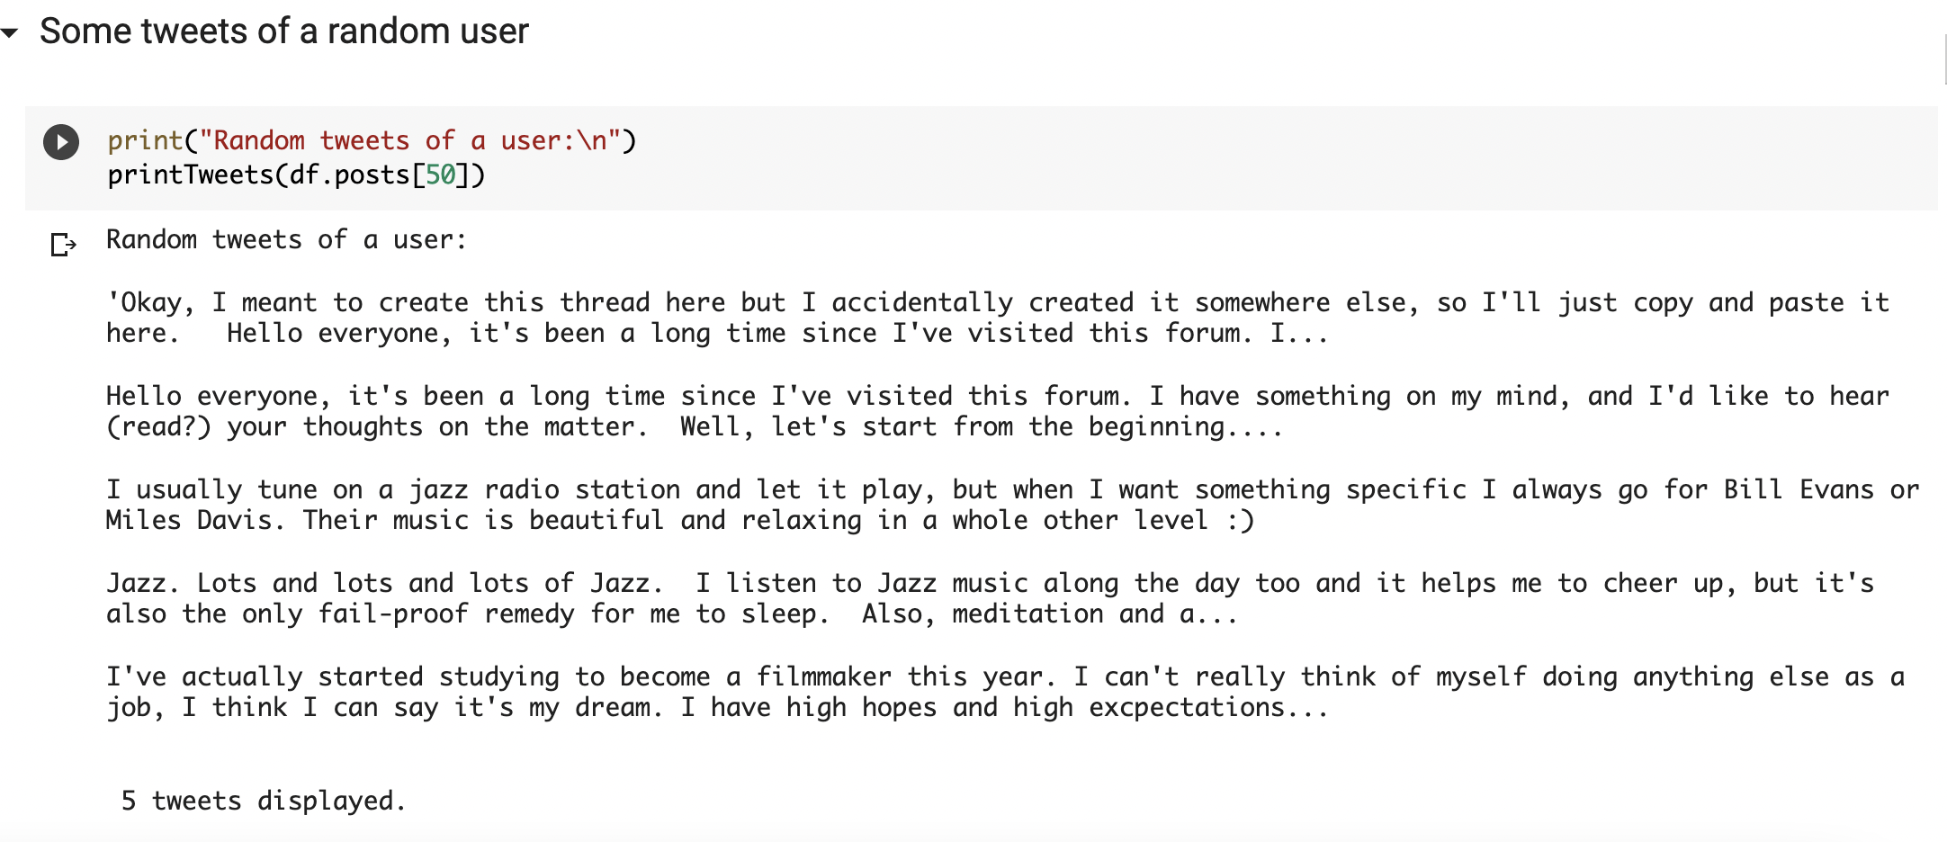
Implementation and Results
Data Loading and Analysis

Slide 21
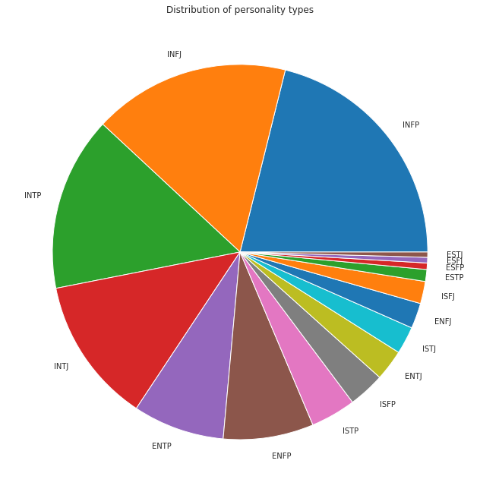
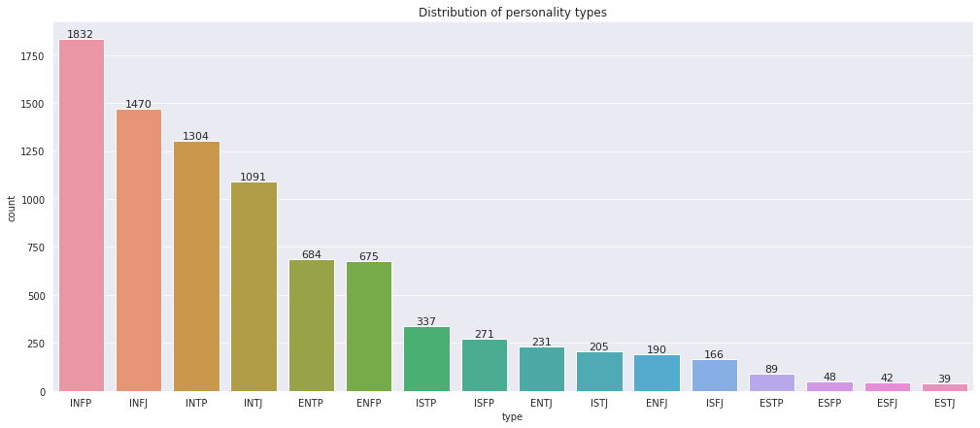
Implementation and Results
Data Loading and Analysis

Slide 22
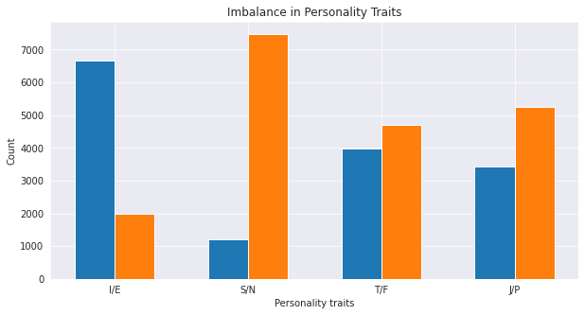
Implementation and Results
Data Loading and Analysis

Slide 23
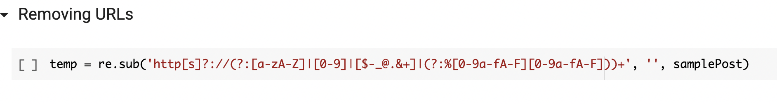
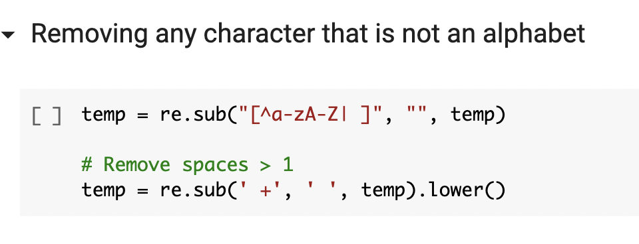
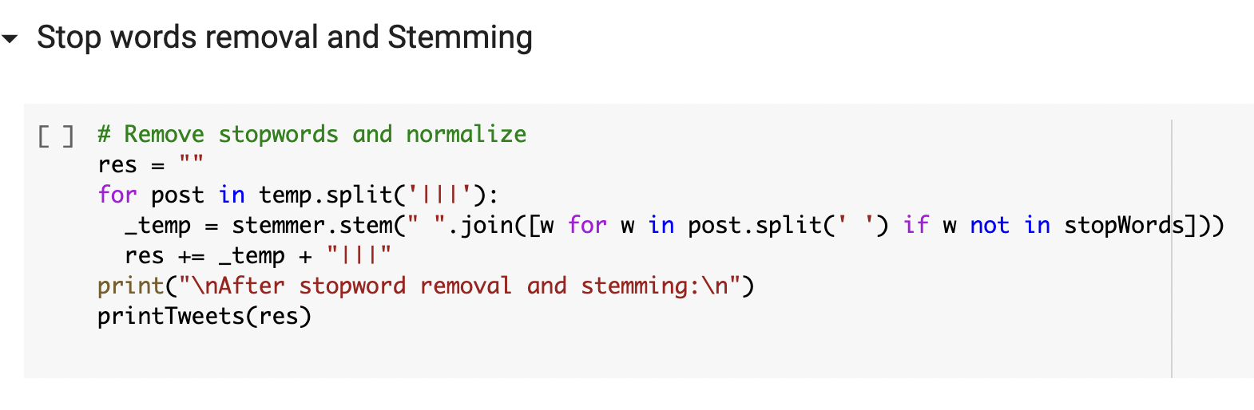
Implementation and Results
Preprocessing

Slide 24
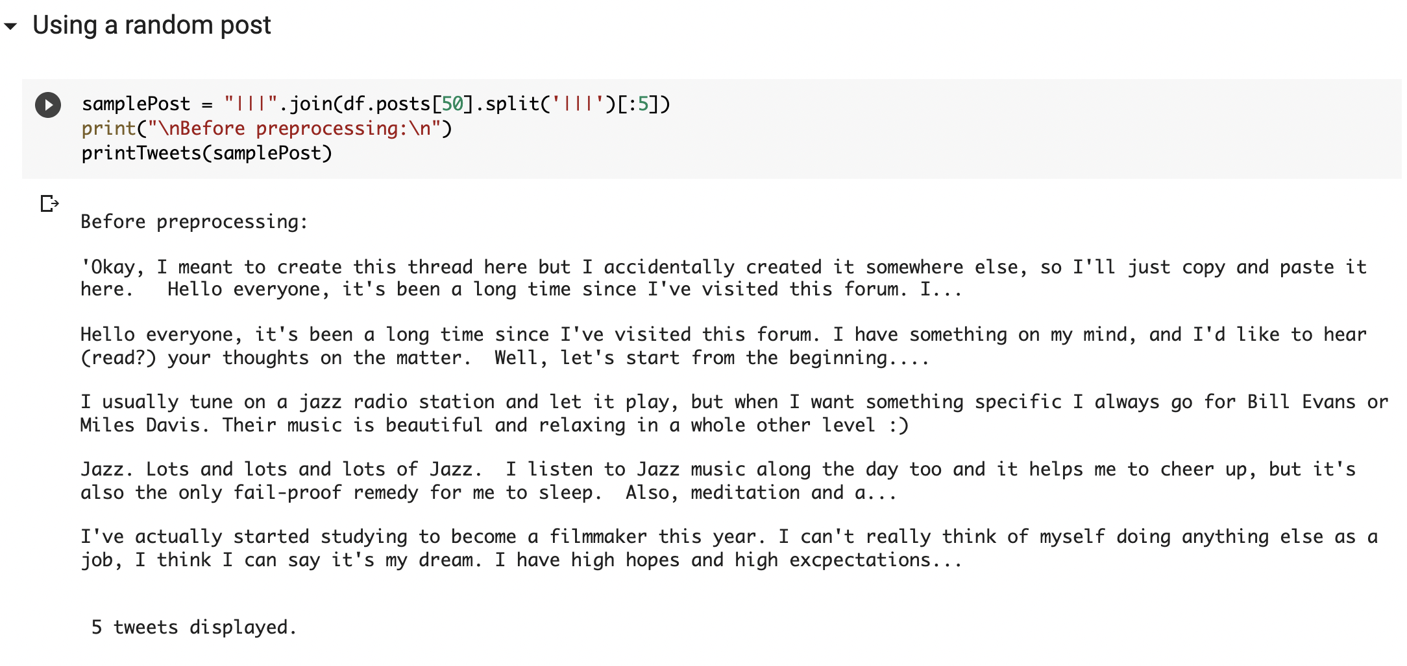
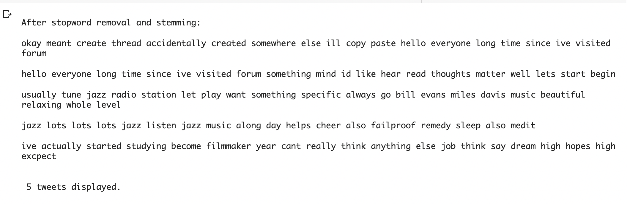
Implementation and Results
Preprocessing
Before Preprocessing
After Preprocessing

Slide 25
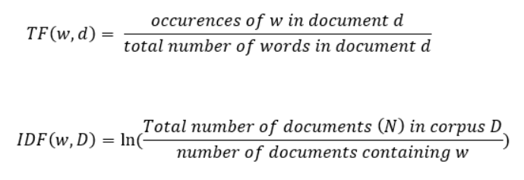
Implementation and Results
Feature Extraction

Slide 26
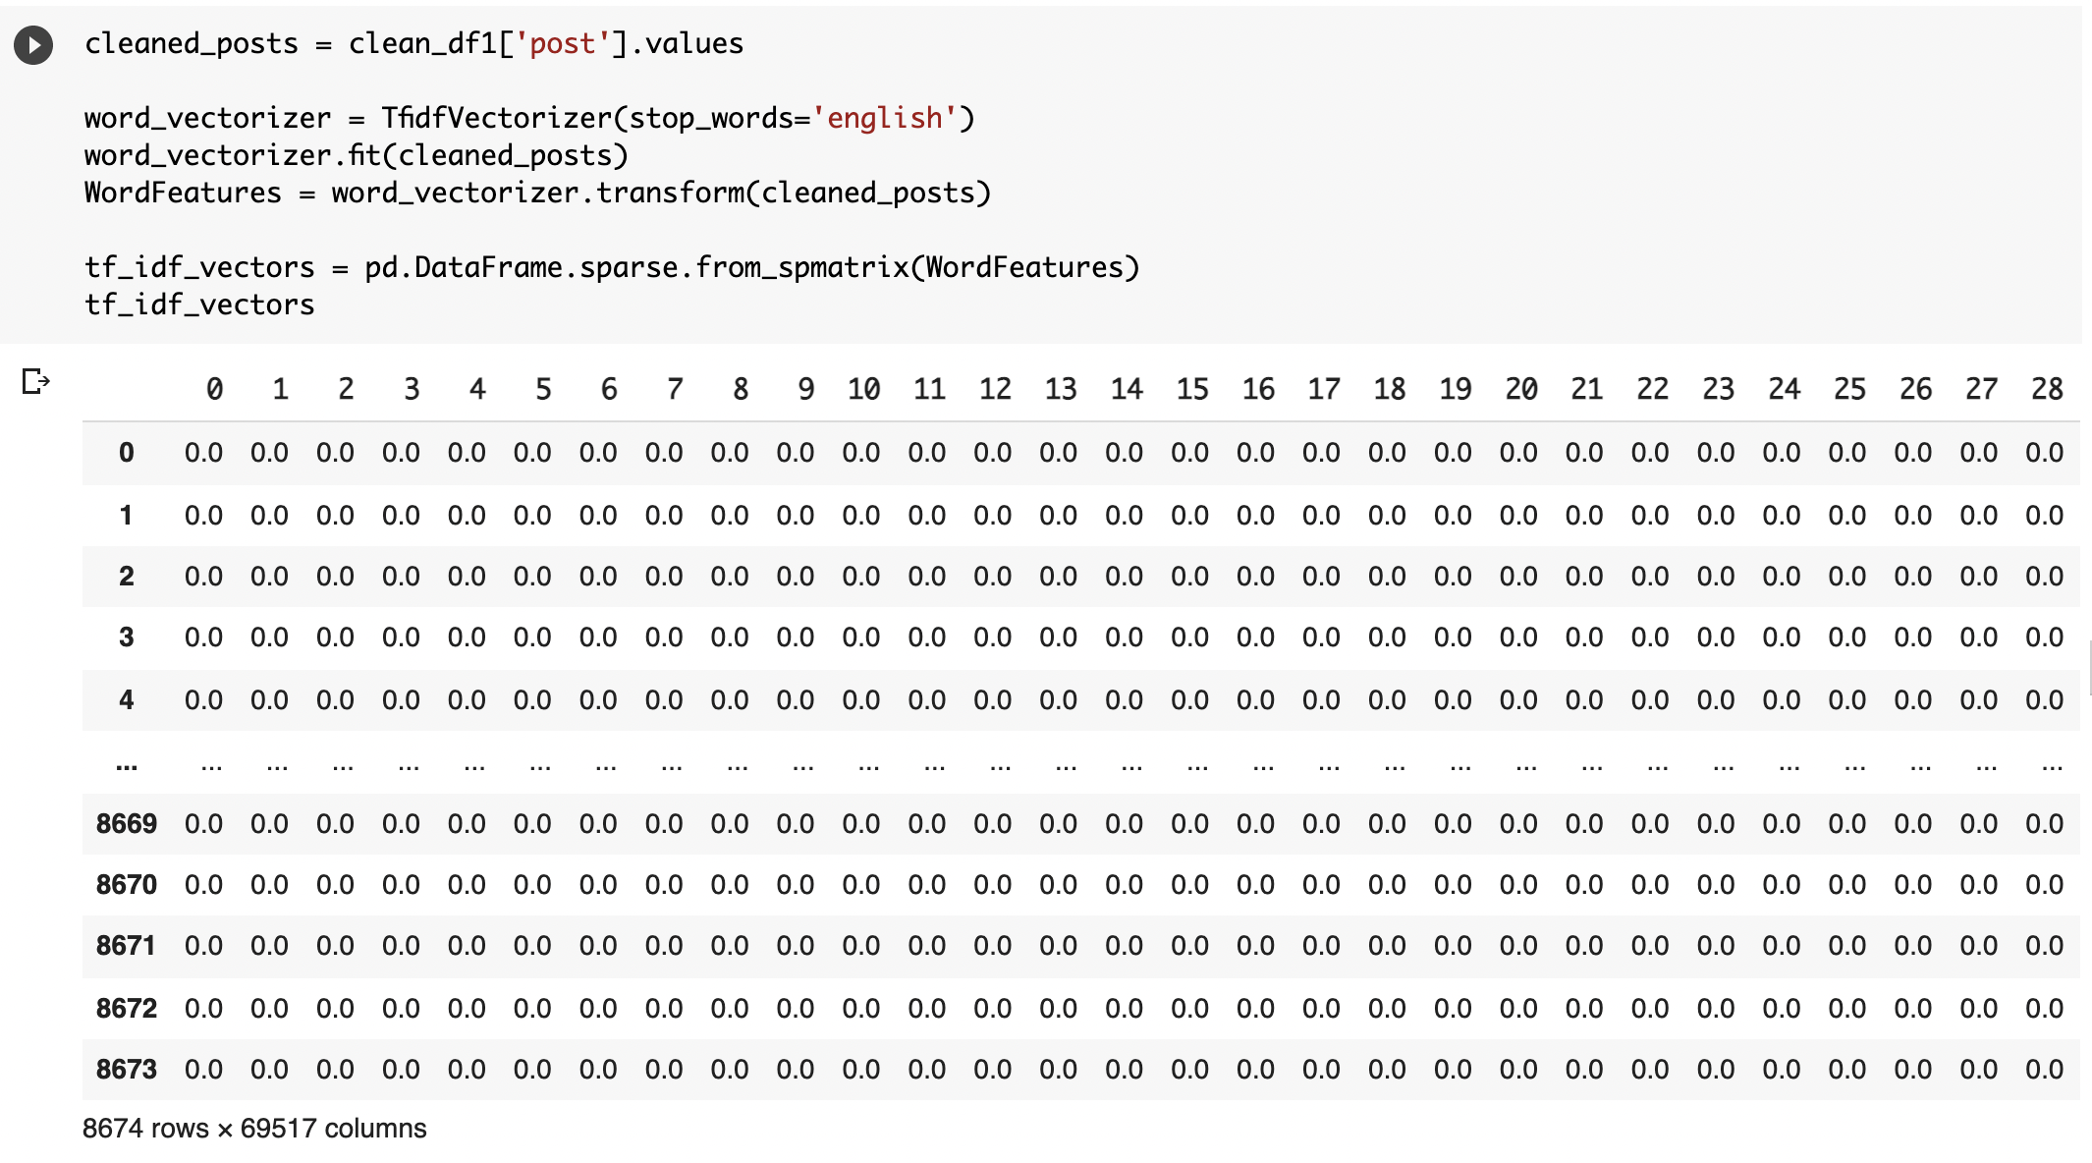
Implementation and Results
Feature Extraction
TF-IDF Vectorization – Sparse Matrix

Slide 27
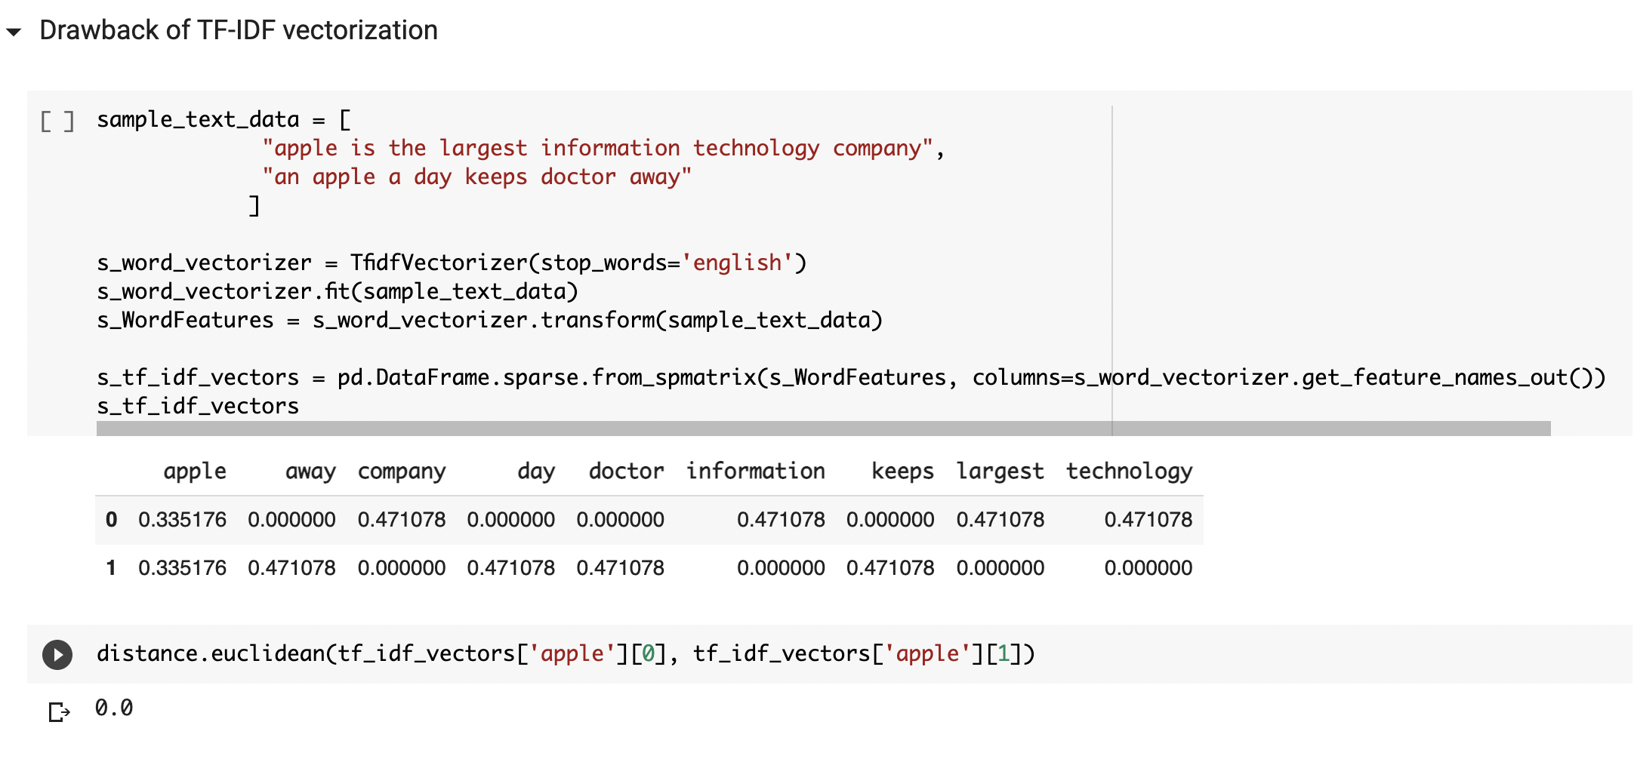
Implementation and Results
Feature Extraction
TF-IDF vectorization doesn't extract the contextual information

Slide 28
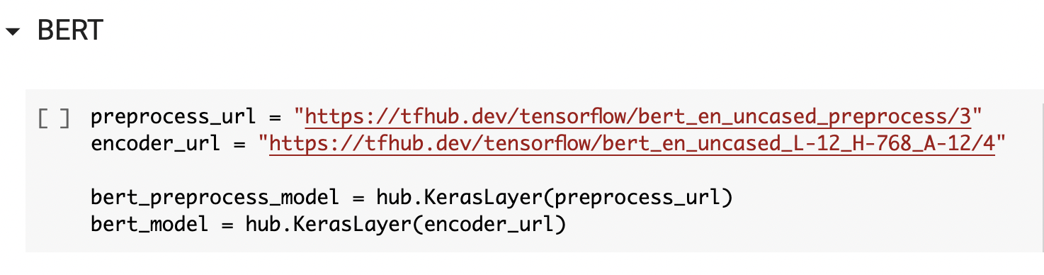
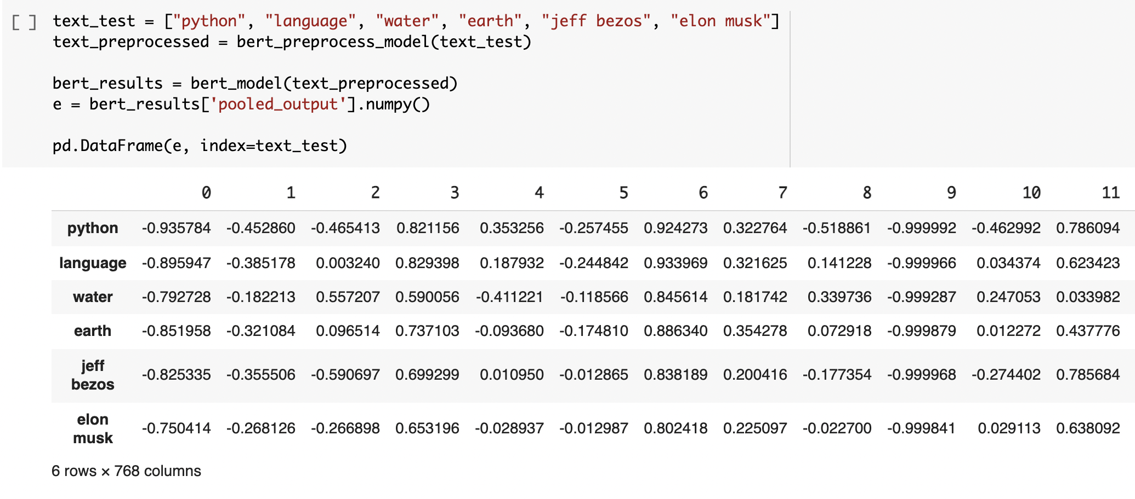
Implementation and Results
Feature Extraction

Slide 29
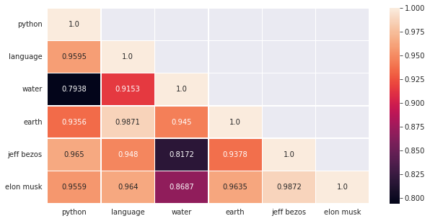
Implementation and Results
Feature Extraction
BERT – Cosine Similarities

Slide 30
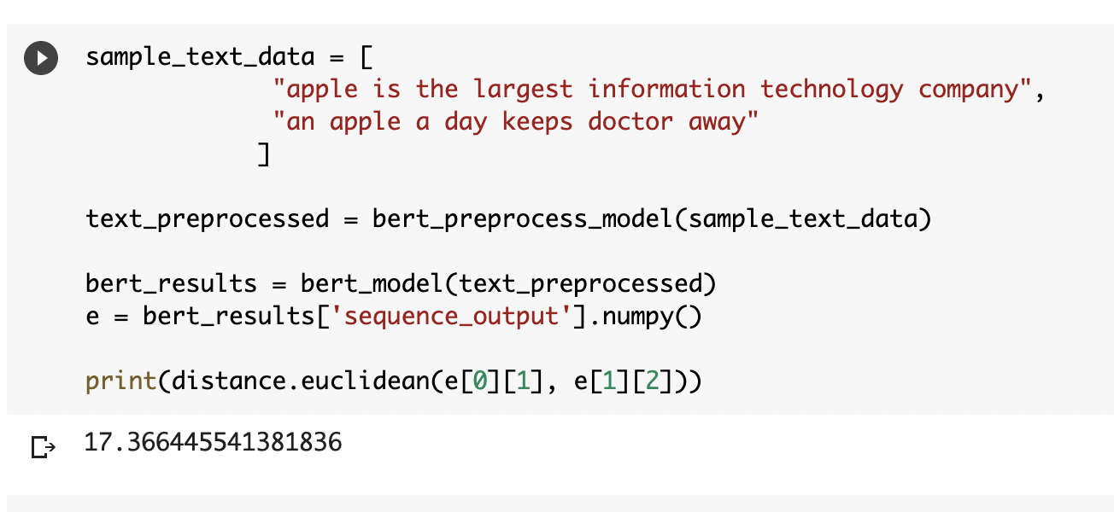
Implementation and Results
Feature Extraction
Here, we can see that BERT uses contextual information to differentiate the two apples.

Slide 31
Conclusion
Social media is being most widely used for social interaction and communication. The study investigates the literature on the uses of social media framework as behavioural feature study by exploring the relationship between users’ personalities and their behaviours in social networks. A user’s behaviour on social platforms is reflected in his/her tweets, posts, comments etc., which in turn reveals traits of his/her personality. From this problem, we infer that a user’s personality is correlated with their online behaviour and hence what a user shares or writes on social media can be used to extract information needed to identify his/her personality, which is valuable in areas of business intelligence and marketing.

Slide 32
References
1. Akrami, N., Fernquist, J., Isbister, T., Kaati, L., and Pelzer, B. (2019). “Automatic extraction of personality from text: Challenges and opportunities.” 2019 IEEE International Conference on Big Data (Big Data). 3156–3164.
2. Christian, H., Suhartono, D., Chowanda, A., and Zamli, K. (2021). “Text based personality prediction from multiple social media data sources using pre-trained language model and model averaging.” Journal of Big Data, 8(68).
3. Keh, S. and Cheng, I. (2019). “Myers-briggs personality classification and personalityspecific language generation using pre-trained language models.” arXiv preprint arXiv.06333.
4. MBTI Twitter Dataset (2017). https://www.kaggle.com/datasnaek/mbti-type.

Slide 33
References
5. myPersonality Dataset (2007). https://sites.google.com/michalkosinski.com/mypersonality.
6. PersonalityCafe Forum (2017). https://www.personalitycafe.com/forums/.
7. Ren, Z., Shen, Q., Diao, X., and Xu, H. (2021). “A sentiment-aware deep learning approach for personality detection from text.” Information Processing & Management, 58.
8. Tadesse, M. M., Lin, H., Xu, B., and Yang, L. (2018). “Personality predictions based on user behavior on the facebook social media platform.” IEEE Access, 6, 61959–61969.
9. Tandera, T., Hendro, Suhartono, D., Wongso, R., and Prasetio, Y. L. (2017). “Personality prediction system from facebook users.” Procedia Computer Science.

Slide 34
THANK YOU

